Slide 1
Find Which restaurant type should be open in Columbia, MO
Krit Pattamadit

Slide 2
Table of Content
Introduction: Business Problem
Data
Methodology
Analysis
Results and Discussion
Conclusion

Slide 3
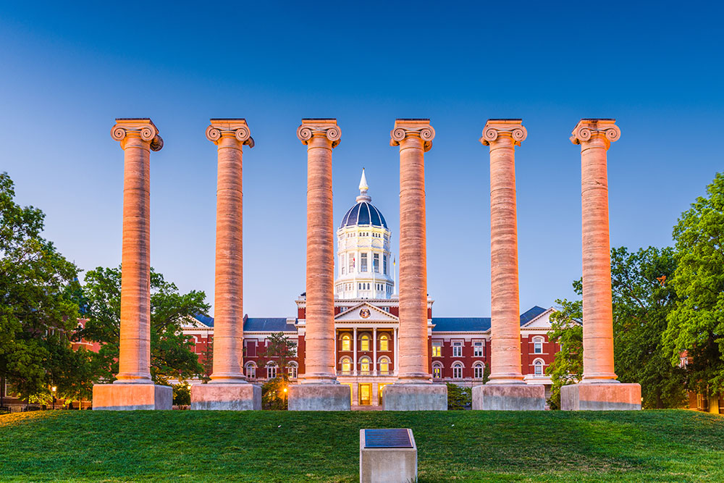
Introduction
Columbia, Missouri is the city I spend most of 5 years to complete degree. Columbia is university city where there are not many types of restaurants or not many types of entertainment area. The goal is using machine learning to recommend what kind of restaurant should it be open in Columbia.

Slide 4
Data
City names in Missouri State along with population Consensus
City list along with lattitude and longtitude
Four Square API

Slide 5
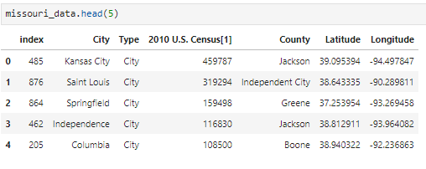
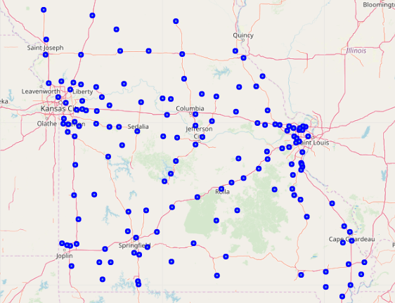
Data

Slide 6
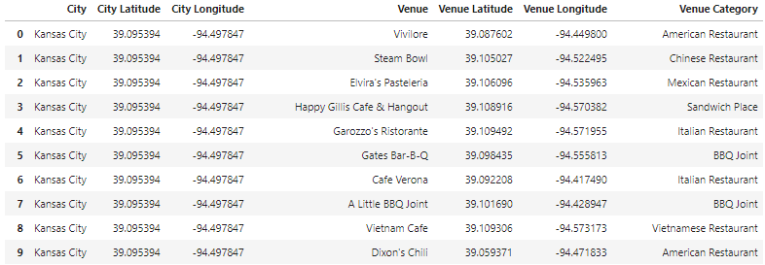
Methodology
Using Missouri City Data to and find Restaurant types from Foursquare API
Then using K-mean Clustering to determine city that have similar pattern in Columbia. And use information to recommend restaurant type

Slide 7
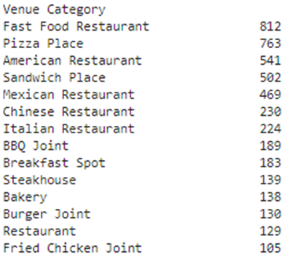
Analysis and discussion
For City in Missouri State top 168 populated City, There are 5681 restaurants with 75 unique category Venues

Slide 8
Analysis and discussion
By using Elbow method to determine suitable number K for clustering algorithm, the suitable number is 12. When apply the k-mean we found out there are 25 city they have similar trait like Columbia city.

Slide 9
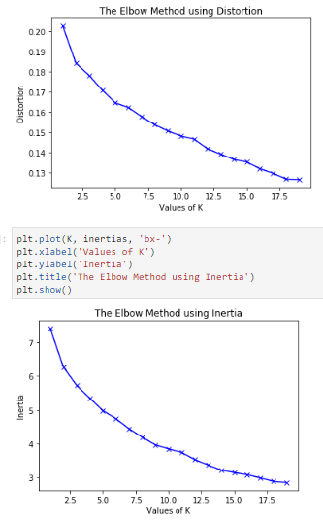
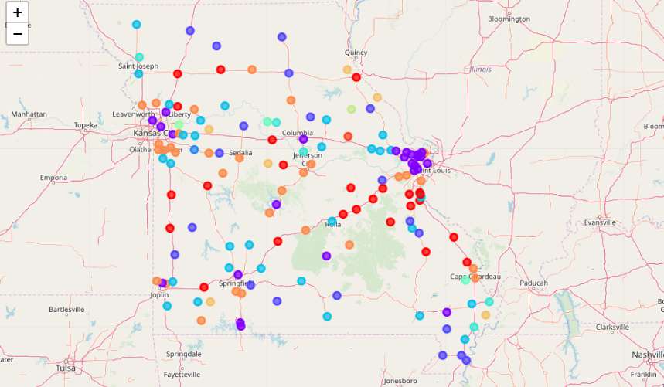
Analysis and discussion

Slide 10
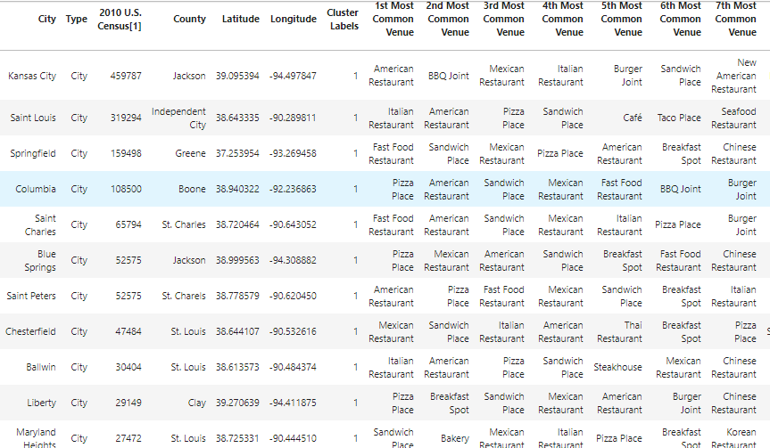
Analysis and discussion

Slide 11
Analysis and discussion
Improvement ideas
Foursquare API - instead using latitude and longitude as the criteria searching, there are might need to searching via searching area instead. Also there are limited search, these could be increase maximum search and increase radius of city
Modeling - the data for modeling use only restaurant type ratio as a feature for clustering model. For improvement, it could include data such as city demographic, restaurant reviews, or include other type of building beside restaurant to find additional factors

Slide 12
Conclusion
Purpose of this project was to find which type of restaurant that likely could open the new one. By grouping pattern restaurant type compare with nearby city in the state. it found out there are around 18 city that similar to Columbia. When upon find detail of the group there are some interesting shop that Columbia didn't open but there are available to other similar city such as Brazilian Caribbean shop. Thus, this would are guideline to help exploration by stakeholders to found new venture.

